Slide 1

Institution: International University – VNU-HCM
Date: August 13th, 2026
CircuitSolver
Team Members:
• Phạm Ngọc Quốc Việt-EEEEIU24010
• Nguyễn Anh Quân-EEACIU25049
• Ngô Phan Minh Quân-EEACIU25050
• Nguyễn Lê Minh Quân-EEACIU25051
• Hoàng Bá Minh Quân-EEACIU25052
Electrical Engineering Learning App with Topology Validation & AI Walkthroughs
PEE Project | 1
Notes:
Target timing: around 7.5-8 minutes without a demo section.
Hello teachers and fellow students. Our group consists of five members: [Name 1], [Name 2], [Name 3], [Name 4], and [Name 5]. Today, our group would like to introduce a learning support application project for the Principles of Electrical Engineering subject, or PEE, designed for engineering students.

Slide 2
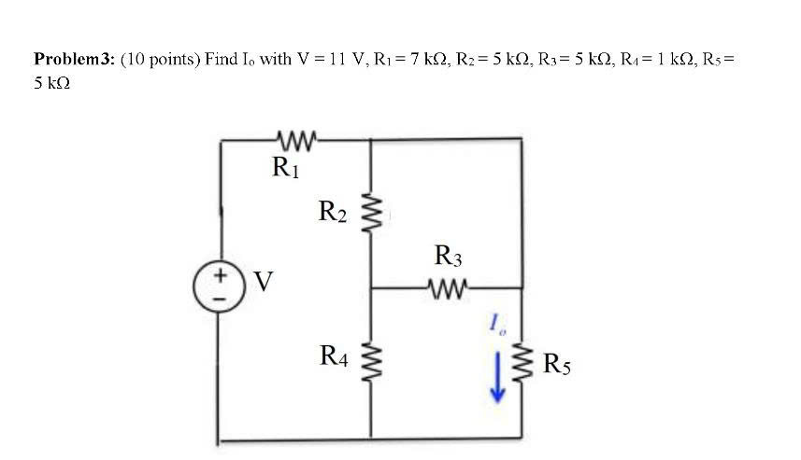
The learning problem
Students need more than final numerical answers.
1. INTRODUCTION AND PROBLEM
When solving PEE circuit problems, students must handle several tasks at the same time:
Perform calculations correctly
Read and interpret circuit diagrams
Identify nodes and connections
Understand why each step is used
Core issue: beginners need guidance on both circuit structure and solution reasoning.
PEE Project | 2
Notes:
When researching how students study and solve electrical circuit problems, our group noticed that students do not only have to calculate final answers. They also need to read circuit diagrams, identify nodes, check whether components are connected correctly, and understand why each solving step is used. This can be difficult for beginners, especially when they are still learning how circuit structure relates to equations.

Slide 3
Gap in existing tools
Professional tools are powerful, but not always beginner-friendly.
1. INTRODUCTION AND PROBLEM
- Current options often create a trade-off:
Powerful
- Professional simulation software can be complexfor beginners:
Simple
- Simpler tools may not explain the solution process clearly enough.
Our question: Can we build a simple, intuitive tool that helps students draw circuits, check them, and understand the solving process?
PEE Project | 3
Notes:
Current tools often create a trade-off. Professional simulation software such as LTspice, Proteus, or Multisim is powerful, but it can feel complex for students who are just starting. On the other hand, simpler tools may be easier to use, but they often do not explain the solving logic clearly. Therefore, our project question is: can we build a simple and intuitive tool that supports both circuit drawing and understanding?

Slide 4
Project solution
A learning workflow built around drawing, checking, analysis, and explanation.
2. SOLUTION AND FEATURES
The application is designed around one practical learning flow:
Draw Circuit
→
Check
→
Analyze
→
Explain
Instead of only producing an answer, the system guides students through the structure and reasoning behind the circuit problem.
PEE Project | 4
Notes:
Our solution is a learning tool built around a simple workflow: draw the circuit, check the circuit structure, analyze the problem, and explain the solution. The purpose is not only to produce a final number. The purpose is to help students move from the visual circuit to the reasoning behind the equations.

Slide 5
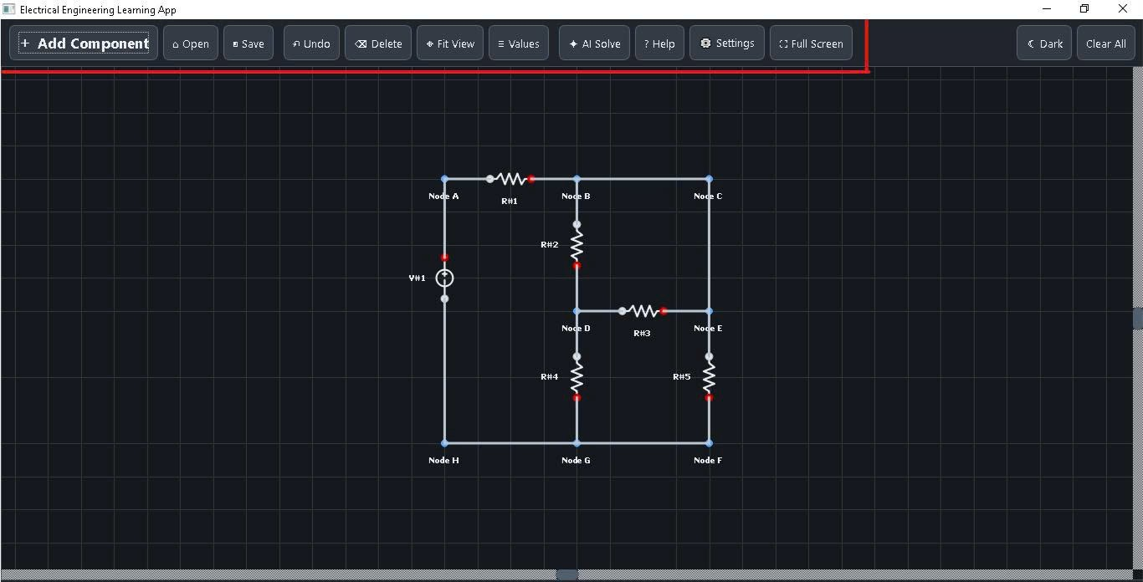
Main features
Three functions support students before and during problem solving.
2. SOLUTION AND FEATURES
1
Interactive circuit drawing
Place components on a grid Canvas, rotate them, edit values, zoom, undo, and connect wires.
2
Topology check
Detect basic structure errors such as unconnected components, open terminals, or separated circuit parts.
3
Save and manage circuits
Save or re-import diagrams as .circuit or .json files for reuse and project management.
PEE Project | 5
Notes:
The application focuses on three main functions. The first is interactive circuit drawing. Users can place components such as resistors, capacitors, inductors, voltage sources, and current sources onto a grid Canvas. The system also supports component rotation, value editing, zooming, undoing, and wiring. The second function is Topology Check, which checks the structure of the circuit and can detect basic issues such as unconnected components, open terminals, or separated circuit parts. The third function is saving and managing circuits, so users can save or re-import diagrams as .circuit or .json files.

Slide 6
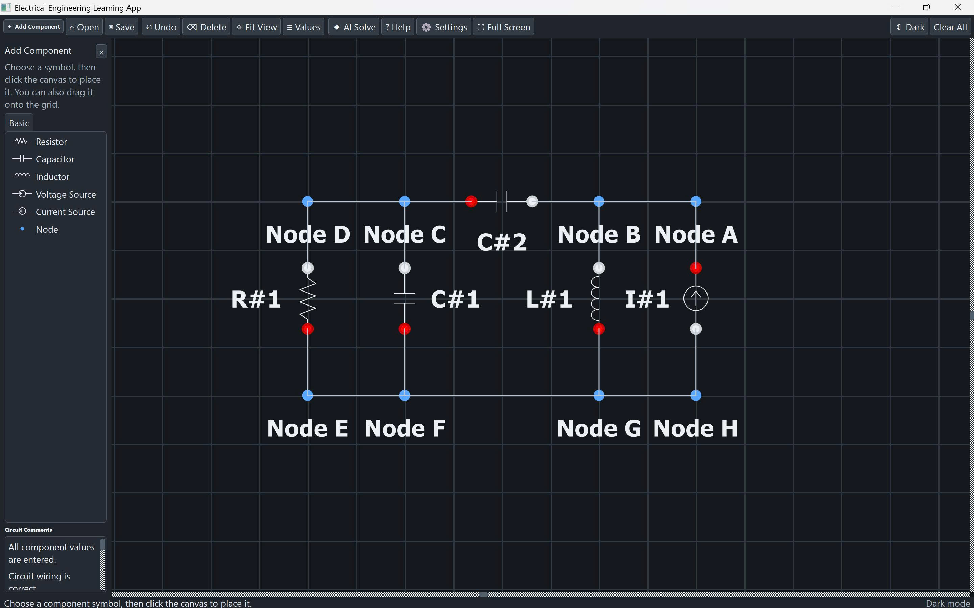
Technical design
A Python desktop application that converts drawings into structured circuit data.
3. TECHNICAL DESIGN
Development stack
Built in Visual Studio Code
Python as the main programming language
PyQt5 for the desktop interface and Canvas
AI provider options
Ollama Local
Google Gemini
OpenAI
The app stores components, values, wires, and terminal connections as data before sending the circuit to the AI analysis layer.
PEE Project | 6
Notes:
Technically, the project was developed in Visual Studio Code, using Python as the main programming language. The current version is built as a PyQt5 desktop application, so the interface, Canvas, and user interactions run directly inside the desktop app. When the user draws a circuit, the program does not treat it as only an image. It stores components, values, wires, and terminal connections as structured data. The system then checks the circuit structure and sends the structured circuit information to the AI analysis layer. For AI support, the system can work with providers such as Ollama Local, Google Gemini, and OpenAI. Finally, the result is displayed using Markdown and KaTeX so equations and explanations are easier to read.

Slide 7
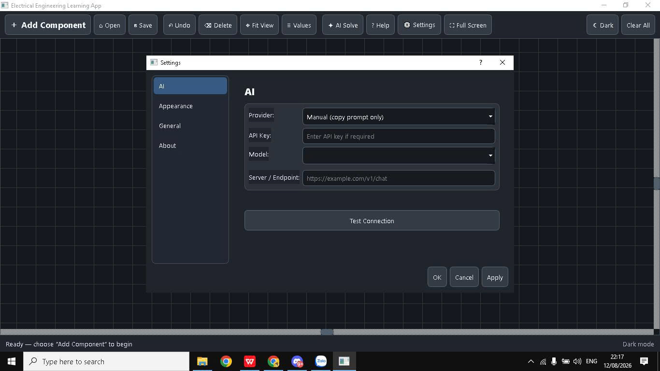
How AI supports learning
The goal is not only to give an answer, but to explain the reasoning.
4. HOW AI SUPPORTS LEARNING
Output structure
Solution
Explanation
Step-by-step process
Why each step is used
Example learning value
For a KCL equation, the system can explain why current flows into or out of a node and why each term appears in the equation.
Important note: AI is a learning support tool, not an absolute verification source.
PEE Project | 7
Notes:
The point our group wants to focus on is not simply having AI provide a final answer. Instead, the output is separated into two learning purposes. The Solution part presents the step-by-step solving process. The Explanation part describes why those steps are performed. For example, instead of only giving a KCL equation, the system can explain why current flows into or out of a node and why each term appears in the equation. This helps students understand not only what the answer is, but also why the answer exists. However, because AI can still produce inaccurate results, we treat it as a learning support tool, not an absolute verification source.

Slide 8
Current Limitations & Strategic Roadmap
Being clear about limitations helps define the next development steps.
5. LIMITATIONS AND ROADMAP
Current Limitations
Future Enhancements
AI output can be inaccurate, so it cannot be used as the only verification source.
Develop an independent circuit solver to verify AI-generated answers.
The current version focuses on structure checking, not a full independent numerical circuit solver.
Expand the component library for more PEE circuit types.
Interactive wiring is still basic and should support more terminal-level control.
Improve wiring controls and validation at the terminal level.
The component library and supported PEE problem types are still limited.
Add more practice modes, examples, and clearer feedback for beginners.
PEE Project | 8
Notes:
Before concluding, we also want to be clear about the current limitations and roadmap. First, the AI output can be inaccurate, so it should not be treated as the only verification source. Second, the current version focuses mainly on structure checking and AI-assisted explanation, not a complete independent numerical circuit solver. Third, interactive wiring is still basic and can be improved with more terminal-level control. Based on these limitations, our roadmap is to develop an independent circuit solver, expand the component library, improve wiring validation, and add more practice modes and clearer feedback for beginners.

Slide 9
Conclusion
A simpler learning tool for students new to electrical circuits.
6. CONCLUSION
This project does not aim to replace professional software such as LTspice, Proteus, or Multisim.
Instead, it combines:
Visual circuit drawing
Automated structure checking
AI-assisted explanation
Main value: helping students understand circuit structure and reasoning before moving to advanced simulation tools.
PEE Project | 9
Notes:
To conclude, our project does not aim to replace professional software such as LTspice, Proteus, or Multisim. Instead, our goal is to build a simpler and more accessible learning tool for students who are new to electrical circuits. The application combines visual circuit drawing, automated structure checking, and AI-assisted explanation. Through this, students can better understand circuit structure and solving logic before moving to more advanced tools. That concludes our group's presentation. Thank you for listening, and we welcome your questions and feedback.

Slide 10

Thank You
For your time and attention
Notes:
To conclude, our project does not aim to replace professional software such as LTspice, Proteus, or Multisim. Instead, our goal is to build a simpler and more accessible learning tool for students who are new to electrical circuits. The application combines visual circuit drawing, automated structure checking, and AI-assisted explanation. Through this, students can better understand circuit structure and solving logic before moving to more advanced tools. That concludes our group's presentation. Thank you for listening, and we welcome your questions and feedback.

